Slide 1


DENTAL DESIGNING
LIBRARY

Slide 2
DENTAL DESIGN
Dental design is an important area of modern dentistry and has a significant impact on a person's smile. Today, achieving a perfect smile in terms of aesthetics, health and function has become the main goal of dental design. So, what is dental design and why is it so important? Let's take a closer look at this topic together.
Dental design is a planned process to achieve an aesthetically and functionally perfect smile, taking into account the shape, colour, size and position of a person’s natural teeth.

Slide 3

IMPORTANCE
OF TOOTH
DESIGNING
IN LIBRARY

Slide 4
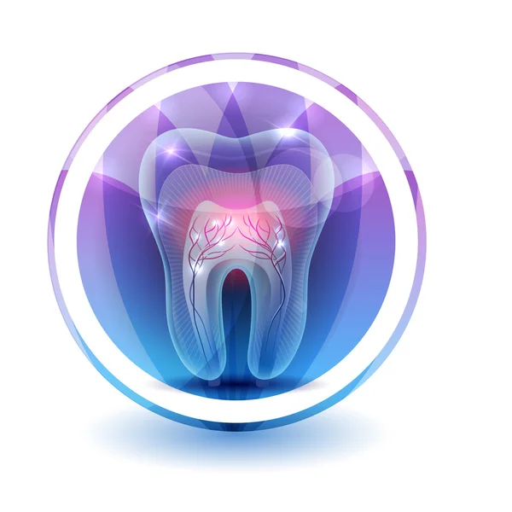
IMPORTANCE OF TOOTH
DESIGNING
In addition to achieving an aesthetically pleasing smile, dental design increases self-confidence and has a positive effect on social relationships. In addition, correct dental design improves chewing function and speech quality and protects oral health.

Slide 5
Importance of tooth design
APPLICATION AREA
OF DENTAL DESIGN
TOOTH DESIGN
PROCESS
Dental design has various fields of application and offers various treatment options to meet different needs. These include the following:
Cosmetic Dentistry: To achieve aesthetic smiles with methods such as teeth whitening, porcelain laminate veneers, aesthetic fillings and smile design.
Restorative Dentistry: The application of treatments such as implants, porcelain crowns, bridges and fillings to repair missing or damaged teeth.
Orthodontic Treatment: The use of methods such as braces, clear aligners and lingual braces to correct the position of the teeth and jaw relationship.
The process of tooth design varies according to the needs and wishes of the person, but generally consists of the following steps:
Inspection and Evaluation: The dentist determines the needs of the person by examining the oral structure and creates a treatment plan.
Treatment Planning: In consultation with the person, the treatment plan is detailed and the treatment methods to be applied are determined.
Treatment Application: Necessary procedures are applied according to the determined treatment plan and the tooth design process is started.
Tracking and Maintenance: After the treatment is completed, the results obtained with regular controls and maintenance are maintained for a long time.

Slide 6

Slide title 29

Slide 7
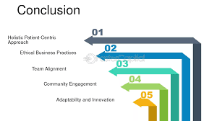
CONCLUSION
Dental design is an important process to achieve a perfect smile in terms of aesthetics, health and function. A correct dental design increases self-confidence, improves social relationships and increases the overall quality of life. Therefore, it is important to collaborate with a specialised dentist during the dental design process. Remember, it is possible to achieve the right smile with the right dental design.
Contracted Institutions

